Slide 1

Company Overview
Notes:
Note: this presentation is updated often. Please look for updates in the Partner Portal.

Slide 2
Profilo aziendale
IT Centric è un System Integrator innovativo che opera principalmente nelle aree Data Center, Networking e Security.
IT Centric è un gruppo in crescita che si propone di evolvere in varie Line of Business.
Un articolato sistema di offerta, con una forte focalizzazione sui servizi di consulenza e system integration, ed una serie di soluzioni verticali, consentono di offrire competenze e soluzioni nei settori delle telecomunicazioni, media, industria, distribuzione, energia.
Attraverso un team di specialisti in diversi settori di mercato e ambiti tecnologici l’azienda riesce a seguire i propri clienti nell’innovazione dei processi tecnologici e nella creazione di un valore dai servizi IT.
Il Gruppo IT Centric eroga servizi evoluti sul territorio italiano ed in alcuni paesi esteri come gli USA e UAE.
Notes:
Since June 2006, more than 2600 users in 74 countries have purchased the enterprise license of Splunk (as of Q1 2011). This includes almost half of the Fortune 100.
Enterprises, service providers and government agencies in 74 countries use Splunk to improve service levels, reduce IT operations costs, mitigate security risks and drive new levels of operational visibility.
As they gain new visibility into their real-time and historical machine data, Splunk’s customers are finding answers and solving the most challenging issues facing IT and the business.

Slide 3

Modello di Business
Mercati di Riferimento
GRANDI INTEGRATORI
INDUSTRIA E SERVIZI
ENERGY & UTILITIES
RETAIL
PA
Centri Competenza
Consulting
System Integration
Cloud e Infrastrutture
Network e Security
Sviluppo Software
Notes:
Since June 2006, more than 2600 users in 74 countries have purchased the enterprise license of Splunk (as of Q1 2011). This includes almost half of the Fortune 100.
Enterprises, service providers and government agencies in 74 countries use Splunk to improve service levels, reduce IT operations costs, mitigate security risks and drive new levels of operational visibility.
As they gain new visibility into their real-time and historical machine data, Splunk’s customers are finding answers and solving the most challenging issues facing IT and the business.

Slide 4












Mercati di riferimento
I nostri specialisti hanno supportato Clienti finali e altri System Integrator nella realizzazione di complessi progetti. Di seguito alcuni riferimenti:
Notes:
Since June 2006, more than 2600 users in 74 countries have purchased the enterprise license of Splunk (as of Q1 2011). This includes almost half of the Fortune 100.
Enterprises, service providers and government agencies in 74 countries use Splunk to improve service levels, reduce IT operations costs, mitigate security risks and drive new levels of operational visibility.
As they gain new visibility into their real-time and historical machine data, Splunk’s customers are finding answers and solving the most challenging issues facing IT and the business.

Slide 5
Numbers
Notes:
Since June 2006, more than 2600 users in 74 countries have purchased the enterprise license of Splunk (as of Q1 2011). This includes almost half of the Fortune 100.
Enterprises, service providers and government agencies in 74 countries use Splunk to improve service levels, reduce IT operations costs, mitigate security risks and drive new levels of operational visibility.
As they gain new visibility into their real-time and historical machine data, Splunk’s customers are finding answers and solving the most challenging issues facing IT and the business.

Slide 6
Principali competenze
Communication
Security
Big Data & Data Virtualization
IoT & Embedded Systems
Data Center
Notes:
Since June 2006, more than 2600 users in 74 countries have purchased the enterprise license of Splunk (as of Q1 2011). This includes almost half of the Fortune 100.
Enterprises, service providers and government agencies in 74 countries use Splunk to improve service levels, reduce IT operations costs, mitigate security risks and drive new levels of operational visibility.
As they gain new visibility into their real-time and historical machine data, Splunk’s customers are finding answers and solving the most challenging issues facing IT and the business.

Slide 7

Competenze
Communication - Collaboration
Notes:
The Splunk architecture scales efficiently to any data volume using commodity hardware.
Splunk can be downloaded and run on a single server in under 5 minutes. The same software can be scaled out across the largest global infrastructures, indexing tens of terabytes of data a day.

Slide 8





CC Communication - Collaboration
Consulting Services
Technologies
Communication
    Assessment e Infrastructure Optimization
    Cisco Communication Platform
    VoIP OpenSource
    Integration VoIP Infrastructure with tradional Voice System
    Monitoring
    Collaboration
    Collaboration Platform
    VideoConference
    Chat and IM & Presence
  Communication
    Cisco Unified Communication Manager
    Cisco Unity
    Asterisk
    Unify Voice Platform
    Cisco Prime Collaboration
  Telepresence
    Cisco Telepresence
    Webex
  Colaboration
    Cisco IM&Presence
    Zimbra
Notes:
Since June 2006, more than 2600 users in 74 countries have purchased the enterprise license of Splunk (as of Q1 2011). This includes almost half of the Fortune 100.
Enterprises, service providers and government agencies in 74 countries use Splunk to improve service levels, reduce IT operations costs, mitigate security risks and drive new levels of operational visibility.
As they gain new visibility into their real-time and historical machine data, Splunk’s customers are finding answers and solving the most challenging issues facing IT and the business.

Slide 9
Competenze
Security - Logical
Notes:
The Splunk architecture scales efficiently to any data volume using commodity hardware.
Splunk can be downloaded and run on a single server in under 5 minutes. The same software can be scaled out across the largest global infrastructures, indexing tens of terabytes of data a day.

Slide 10
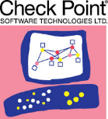




CC Security - Logical
Consulting Services
Technologies
Enterprise Security
  Security Policy and Compliance (ISO 27001, PCI-DSS, etc.)
  Security Assessment (Vulnerability and Risk Assessment)
  Security Infrastructure
    Assessment, Design and Infrastructure Optimization
    Log Retention and Correlation
    Public Key Infrastructure
    Anomaly and Intrusion Detection
  Security Access
    Network Identity and Access Control
  NGFW, IDS & IPS
      Cisco / SourceFire
      Checkpoint & Fortinet
  Security Information Event Management
        Splunk, Alien Vault, nFX
DDoS Mitigation and Anomaly Detection
  Cisco Guard
  Security Identity & Access Management
    Cisco Identity Service Engine
  Security Web Access
    OpenDNS
    Websense
    BlueCoat
Notes:
Since June 2006, more than 2600 users in 74 countries have purchased the enterprise license of Splunk (as of Q1 2011). This includes almost half of the Fortune 100.
Enterprises, service providers and government agencies in 74 countries use Splunk to improve service levels, reduce IT operations costs, mitigate security risks and drive new levels of operational visibility.
As they gain new visibility into their real-time and historical machine data, Splunk’s customers are finding answers and solving the most challenging issues facing IT and the business.

Slide 11
Competenze
Security – Physical
Notes:
The Splunk architecture scales efficiently to any data volume using commodity hardware.
Splunk can be downloaded and run on a single server in under 5 minutes. The same software can be scaled out across the largest global infrastructures, indexing tens of terabytes of data a day.

Slide 12


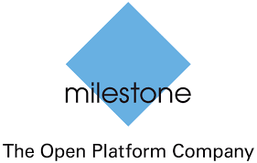

CC Security – Physical
Consulting Services
Technologies
PS Design
  Design and Implementation
  Area Coverage and Law Compliance
  Intrusion Detection and Access Control Systems, IR and Fiber Sensors
PS Systems
  VMS, ACS, IDS
  PSIM
  Video Analysis
  Generic sensors integration
  VMS
      Cisco
      Milestone, Axis
      Mobotix
        Genetec
        Synectics
  ACS
    Cisco, Axis, Honeywell & HID
  IDS
      Optasense
Notes:
Since June 2006, more than 2600 users in 74 countries have purchased the enterprise license of Splunk (as of Q1 2011). This includes almost half of the Fortune 100.
Enterprises, service providers and government agencies in 74 countries use Splunk to improve service levels, reduce IT operations costs, mitigate security risks and drive new levels of operational visibility.
As they gain new visibility into their real-time and historical machine data, Splunk’s customers are finding answers and solving the most challenging issues facing IT and the business.

Slide 13
Competenze
Data Center
Notes:
The Splunk architecture scales efficiently to any data volume using commodity hardware.
Splunk can be downloaded and run on a single server in under 5 minutes. The same software can be scaled out across the largest global infrastructures, indexing tens of terabytes of data a day.

Slide 14





CC Data Center
Consulting Services
Technologies
Design and Implementation
  Data Center Virtualization and Consolidation
  Private Cloud
  Automation and Orchestration
  Disaster Recovery and Business Continuity
  Storage Area Network
  Software Defined Storage
Management and Control
  Data Center Monitoring and Alerting
  Virtualization
      VMware vSphere and NSX
      Microsoft Hyper-V
  Private Cloud
    RedHat CloudForms
    VMware vRealize Automation
  Disaster Recovery and Business Continuity
    VMware Site Recovery Manager
    NetApp MetroCluster
  Management
    Cisco UCS Director
    Cisco DCNM
Notes:
Since June 2006, more than 2600 users in 74 countries have purchased the enterprise license of Splunk (as of Q1 2011). This includes almost half of the Fortune 100.
Enterprises, service providers and government agencies in 74 countries use Splunk to improve service levels, reduce IT operations costs, mitigate security risks and drive new levels of operational visibility.
As they gain new visibility into their real-time and historical machine data, Splunk’s customers are finding answers and solving the most challenging issues facing IT and the business.

Slide 15



CC Data Center
Consulting Services
Technologies
Design
  Assessment, Design and Optimization
    Cooling
    Physical Security
    Electrical
    Cabling
Management and Control
  Design and Implementation of Datacenter Infrastructure Management Solutions
Compliance
  Classification of DC Tiering based on Uptime Institute guidelines
  UPS, Cooling and Containement
      Emerson
      APC – Schenider
      Uniflair
      Rittal
  GE
    Coelmo
  Electrical
    Schenider / Siemens
  DCIM and Control Systems
    Avocent
    Cormant / CableSolve
Notes:
Since June 2006, more than 2600 users in 74 countries have purchased the enterprise license of Splunk (as of Q1 2011). This includes almost half of the Fortune 100.
Enterprises, service providers and government agencies in 74 countries use Splunk to improve service levels, reduce IT operations costs, mitigate security risks and drive new levels of operational visibility.
As they gain new visibility into their real-time and historical machine data, Splunk’s customers are finding answers and solving the most challenging issues facing IT and the business.

Slide 16
Competenze
Big Data & Data Virtualization
Notes:
The Splunk architecture scales efficiently to any data volume using commodity hardware.
Splunk can be downloaded and run on a single server in under 5 minutes. The same software can be scaled out across the largest global infrastructures, indexing tens of terabytes of data a day.

Slide 17



CC Big Data & Data Virtualization
Consulting Services
Technologies
Big Data
  Design and Integration of Big Data Infrastructures
Data Virtualization
  Analysis and Design for Data Virtualization Infrastructures
  Cisco Data Virtualization Platfom
Automation
  Infrastracture Automation and Orchestration
  Big Data
      Hadoop & Cloudera
      MongoDB
      Splunk
      Elastic Search
  Data Virtualization
    Cisco CIS
  Automation
      Puppet
Notes:
Since June 2006, more than 2600 users in 74 countries have purchased the enterprise license of Splunk (as of Q1 2011). This includes almost half of the Fortune 100.
Enterprises, service providers and government agencies in 74 countries use Splunk to improve service levels, reduce IT operations costs, mitigate security risks and drive new levels of operational visibility.
As they gain new visibility into their real-time and historical machine data, Splunk’s customers are finding answers and solving the most challenging issues facing IT and the business.

Slide 18
Competenze
IoT & Embedded Systems
Notes:
The Splunk architecture scales efficiently to any data volume using commodity hardware.
Splunk can be downloaded and run on a single server in under 5 minutes. The same software can be scaled out across the largest global infrastructures, indexing tens of terabytes of data a day.

Slide 19





CC IoT & Embedded Systems
Consulting Services
Technologies
IoT
  Design and Implementation of Full Mesh and P2P Sensor Networks
  Integration of Programmable Microcontrollers
  Integration in Security, Industry and Automotive systems
Software
  SCADA Integration
  Legacy protocols gateways
  Programmable Microcontrollers
      Arduino
      Raspberry
      Splunk
  Radio
    Bluetooth
    ZigBee
    LoRa
    LTE
    802.11p
Notes:
Since June 2006, more than 2600 users in 74 countries have purchased the enterprise license of Splunk (as of Q1 2011). This includes almost half of the Fortune 100.
Enterprises, service providers and government agencies in 74 countries use Splunk to improve service levels, reduce IT operations costs, mitigate security risks and drive new levels of operational visibility.
As they gain new visibility into their real-time and historical machine data, Splunk’s customers are finding answers and solving the most challenging issues facing IT and the business.

Slide 20
R&D
Soluzioni IoT e Intelligent Transport Systems
Notes:
The Splunk architecture scales efficiently to any data volume using commodity hardware.
Splunk can be downloaded and run on a single server in under 5 minutes. The same software can be scaled out across the largest global infrastructures, indexing tens of terabytes of data a day.

Slide 21
R&D
IT Centric investe nella ricerca e lo sviluppo di soluzioni innovative in due ambiti principali:
Piattafome e soluzioni per Internet of Things (IoT)
  Sensor Networks
Soluzioni per l’Intelligent Transportation Systems (ITS)
Notes:
Since June 2006, more than 2600 users in 74 countries have purchased the enterprise license of Splunk (as of Q1 2011). This includes almost half of the Fortune 100.
Enterprises, service providers and government agencies in 74 countries use Splunk to improve service levels, reduce IT operations costs, mitigate security risks and drive new levels of operational visibility.
As they gain new visibility into their real-time and historical machine data, Splunk’s customers are finding answers and solving the most challenging issues facing IT and the business.

Slide 22
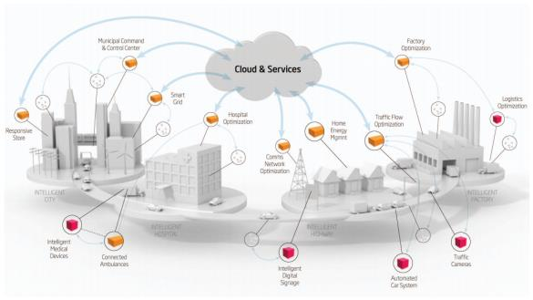
R&D– Piattaforma IoT (1/2)
Internet Of Things: Interconnettere ogni dispositivo e sensore, identificando e correlando le informazioni
SECaaS Cloud Platform: collezionare eventi raw da sorgenti multiple, creando allarmi, correlando tra loro le informazioni e realizzando una piattaforma con paradigma Security as a Service
Tipi di Sorgenti:
  Video Surveillance
  Video Analysis
  Physical Access Control
  Intrusion detection
Notes:
Since June 2006, more than 2600 users in 74 countries have purchased the enterprise license of Splunk (as of Q1 2011). This includes almost half of the Fortune 100.
Enterprises, service providers and government agencies in 74 countries use Splunk to improve service levels, reduce IT operations costs, mitigate security risks and drive new levels of operational visibility.
As they gain new visibility into their real-time and historical machine data, Splunk’s customers are finding answers and solving the most challenging issues facing IT and the business.

Slide 23
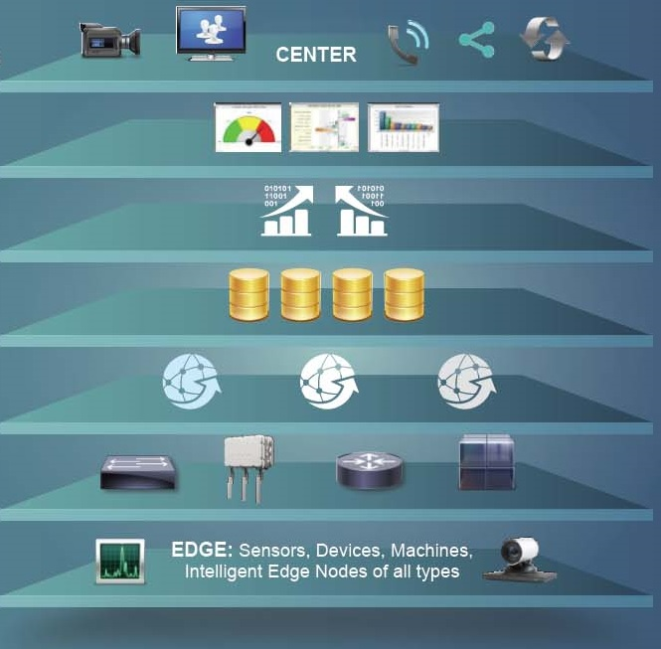
R&D– Piattaforma IoT (2/2)
Incident Handling and Alarm Response
Punti Chiave
Paradigma IoT
Fixed and Mobile Sensor
Video Analysis
Analytics e Correlation
Alerting
Security Process Automation
Legacy Interoperability
Application (Reporting, Analytics, Control e Alerting)
Data Abstraction, Correlation
Cloud Event Storage
Edge Computing
Connettività
Sensori e Dispositivi
Notes:
Since June 2006, more than 2600 users in 74 countries have purchased the enterprise license of Splunk (as of Q1 2011). This includes almost half of the Fortune 100.
Enterprises, service providers and government agencies in 74 countries use Splunk to improve service levels, reduce IT operations costs, mitigate security risks and drive new levels of operational visibility.
As they gain new visibility into their real-time and historical machine data, Splunk’s customers are finding answers and solving the most challenging issues facing IT and the business.

Slide 24
R&D– Sensor Network
Progettazione di Sensor Network Full Mesh o P2P
Programmazione di microcontrollori e sistemi embedded
Applicazione:
  Home Automation
  Domotica
  Localizzazione
  Monitoraggio
  Access Control
Notes:
Since June 2006, more than 2600 users in 74 countries have purchased the enterprise license of Splunk (as of Q1 2011). This includes almost half of the Fortune 100.
Enterprises, service providers and government agencies in 74 countries use Splunk to improve service levels, reduce IT operations costs, mitigate security risks and drive new levels of operational visibility.
As they gain new visibility into their real-time and historical machine data, Splunk’s customers are finding answers and solving the most challenging issues facing IT and the business.

Slide 25
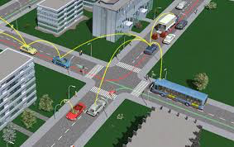
R&D– Intelligent Transport Systems
Prototipazione di sistemi ITS
Infrastrutture di Comunicazione per Veichle To Infrastructure (V2I)
Sistemi di comunicazione Vehicle to Veichle (V2V)
Notes:
Since June 2006, more than 2600 users in 74 countries have purchased the enterprise license of Splunk (as of Q1 2011). This includes almost half of the Fortune 100.
Enterprises, service providers and government agencies in 74 countries use Splunk to improve service levels, reduce IT operations costs, mitigate security risks and drive new levels of operational visibility.
As they gain new visibility into their real-time and historical machine data, Splunk’s customers are finding answers and solving the most challenging issues facing IT and the business.

Slide 26
info@itcentric.it
Notes:
Note: this presentation is updated often. Please look for updates in the Partner Portal.

